Slide 1
Gender Recognition by Voice
107753017
107753045

Slide 2
Goal
Identify a voice as male or female

Slide 3
Data
Input format: .csv
20 columns features
3168 datas
Male : Female
1584 : 1584 = 1 : 1

Slide 4
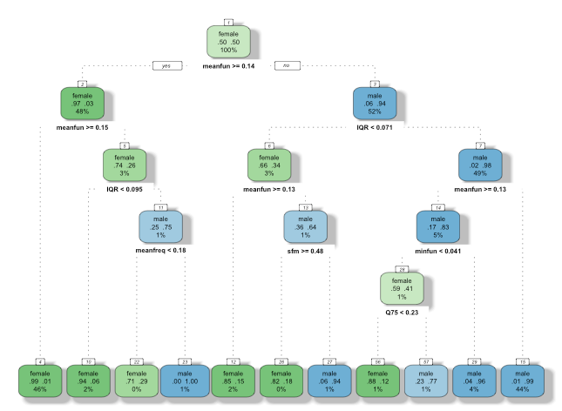
Extra separated data (decission tree)
meanful
IQR
minfun
sfm
maxdom

Slide 5
Cross-validation
k-fold
10 folds
Source: https://en.wikipedia.org/wiki/Confusion_matrix

Slide 6
Libsvm
library(e1071)
NTU Professor Chih-Jen Lin

Slide 7
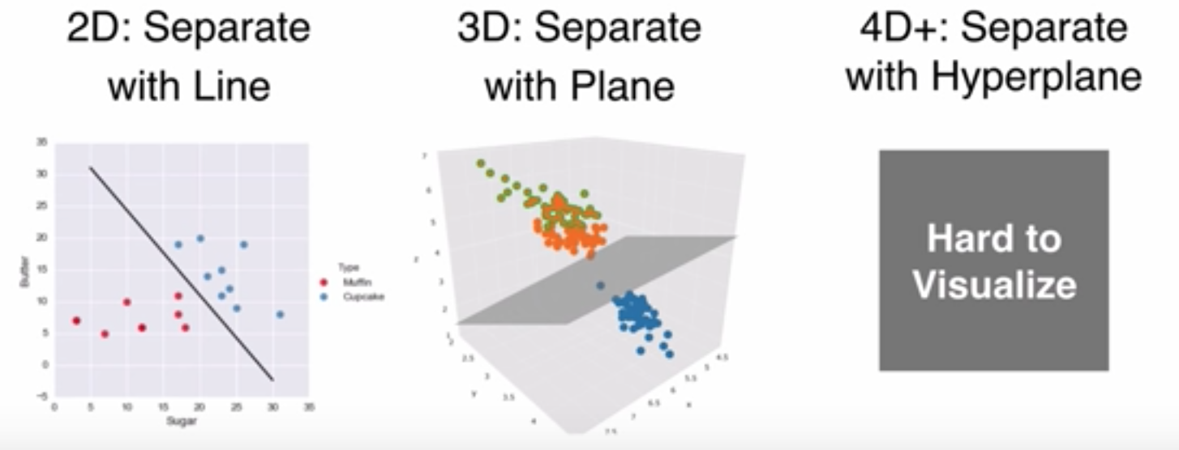
Libsvm
Source: https://www.youtube.com/watch?v=N1vOgolbjSc

Slide 8
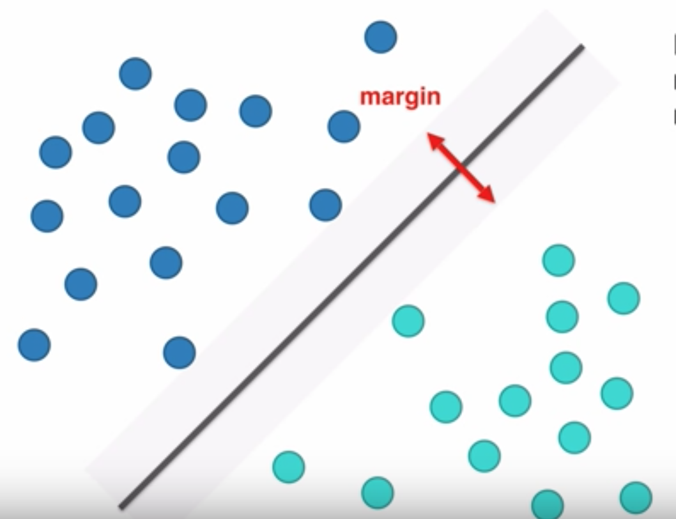
Libsvm
Source: https://www.youtube.com/watch?v=N1vOgolbjSc

Slide 9
measurement
Source: https://en.wikipedia.org/wiki/Confusion_matrix

Slide 10
Results
Testdata
Traindata
 | Sensitivity | Specificity | Accuracy
SVM | 0.9932 | 0.9586 | 0.9748
 | Sensitivity | Specificity | Accuracy
SVM | 0.9868 | 0.9845 | 0.9856

Slide 11
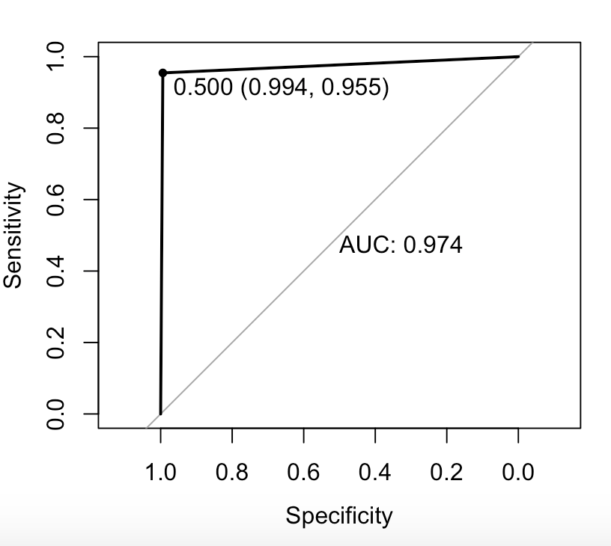
AUC

Slide 12
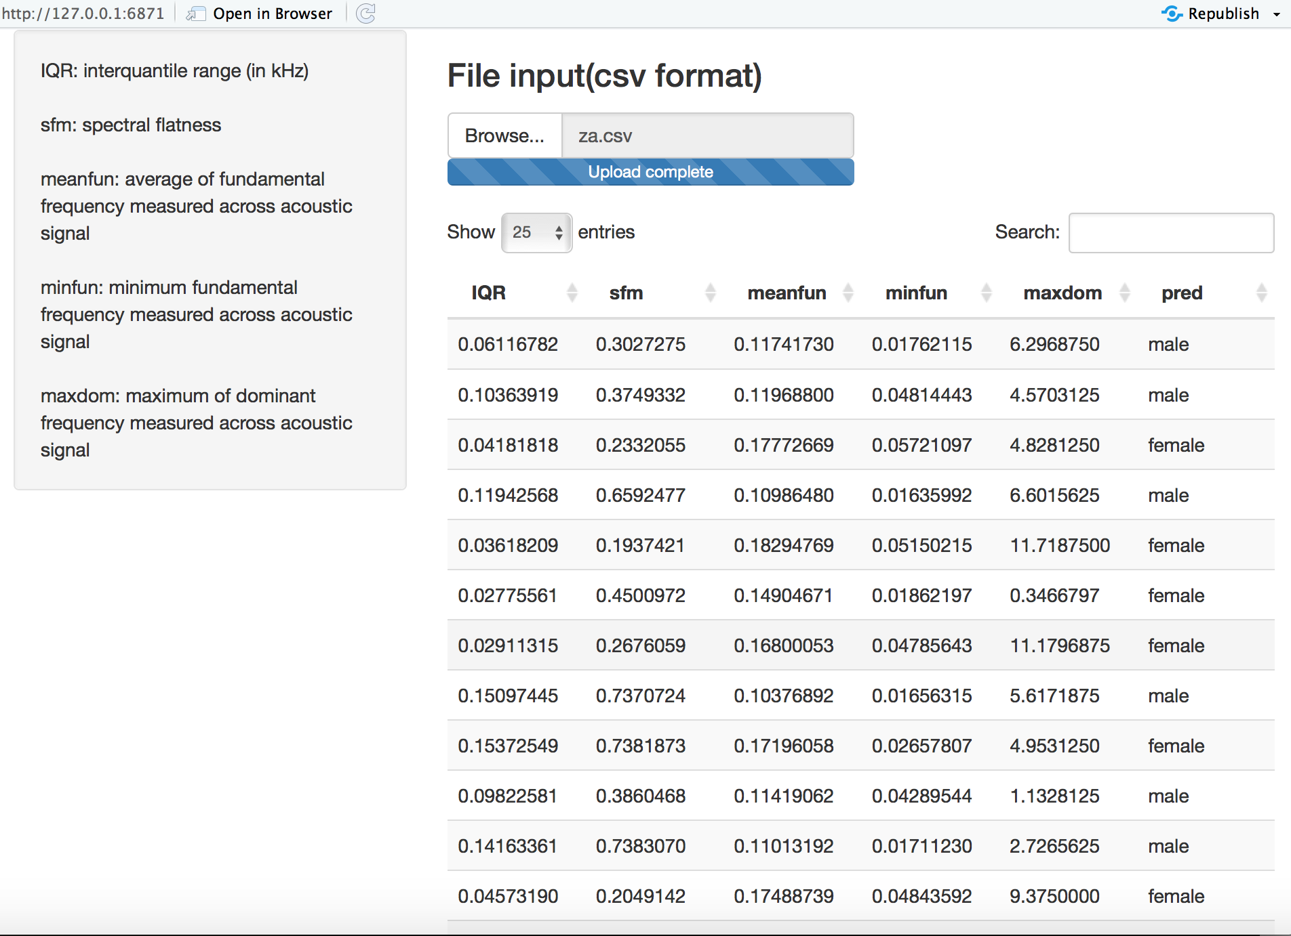
Shiny

Slide 13
Comparison
 | Sensitivity | Specificity | Accuracy
SVM | 0.9932 | 0.9586 | 0.9748
Random Forest | 0.9932 | 0.9586 | 0.9748
Decision Tree | 0.9865 | 0.9583 | 0.9715
Naïve Bayes | 0.8986 | 9.8876 | 0.8927
KNN | 0.7095 | 0.7041 | 0.7066

Slide 14
Challenge
Extra separated data
K-folds cross validation
Reasons of high Accuracy:
Numerical features
Balanced classification
minor dataset (testdata)

Slide 15
Reference
LIBSVM: A Library for Support Vector Machines https://www.csie.ntu.edu.tw/~cjlin/papers/libsvm.pdf
ROC
https://zh.wikipedia.org/wiki/ROC%E6%9B%B2%E7%BA%BF
Cross-validation
https://en.wikipedia.org/wiki/Cross-validation_(statistics)

